Slide 1
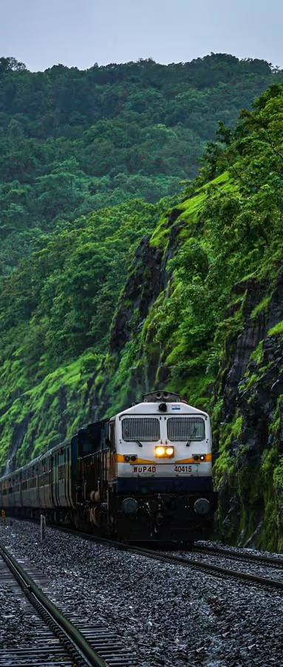
Reservation System
Group 1:
Hasin Arman (22CS8001), Anwesha Roy Oishi (22CS8002), Mohammad Salman Ali (22CS8003), Aquib Alam Khan (22CS8004), Aryaman Jai (22CS8005), MD Jahid Hasan (22CS8006), Mushkan Kumari (22CS8007), Baskaran Vaishnavan (22CS8008), Pratham Nandy (22CS8009), Chenna Reddy Kumar Sankar Reddy (22CS8010)

Slide 2
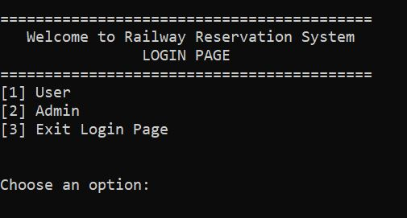
System Overview: Login
Login Page: The main interface to access the server or the user side amenities
Admin Login: Admin needs to login to start the server
User Page: Users can register, login, reserve seat, view seats, etc…

Slide 3
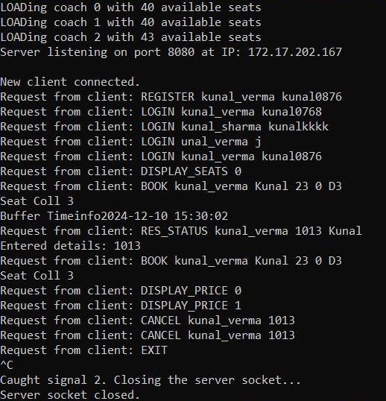
System Overview: Server
One of the key components of the reservation system is the server.. It’s functioning is as follows:
Admin starts the server
Admin monitors the user requests made to the server
The server processes the user requests and relays required response back to the user
Stores all information of the server in a text file
Can handle multiple clients
Synchronisation with help of semaphores

Slide 4
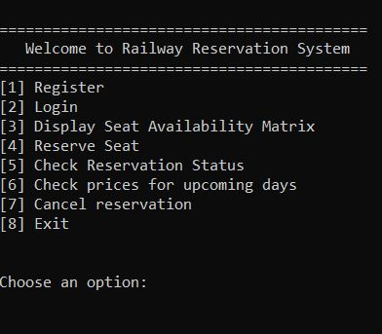
System Overview: Client Module
This module’s purpose is for users to interact with the server. Through this, Users can:
Register as a client
Login as a client
Reserve preferred seat in preferred coach
View available seats along with prices
View prices for upcoming days
Cancel reservation

Slide 5
System Overview: Features
Users can register using a unique username and password
Using registered username and password they can login as a client
Users get assigned a unique ticket number (PNR) upon successful reservation of seat
The PNR can be used to view the reservation status (whether successfully booked or waitlisted) and cancel reservation
Users are prompted to select another seat (in case preferred seat is already booked)
User is put in a waiting list in case of unavailability of seats in the preferred coach (priority to older passengers)
Upon cancellation, person from waiting list is assigned the seat

Slide 6
Reservation Overview
There are three separate coaches with different base prices
Users can also see a visual layout of the train (position of the coaches with respect to the engine)
Users can also view prices for upcoming dates
Seat Matrix:
Users can see seat numbers along with prices in form a matrix
Window seats cost more than other seats
Dynamic Pricing:
Depends on demand factor, cancellation factor and time factor
Final Price=Base Price*Demand factor*Cancellation Factor*Time Factor

Slide 7
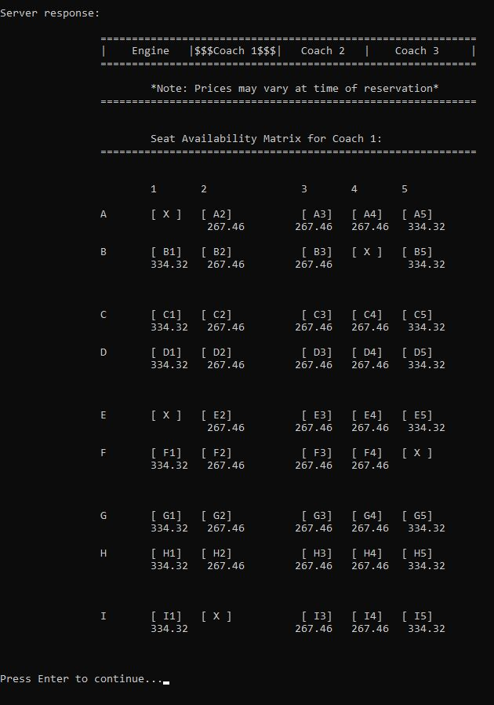
Seat Matrix

Slide 8
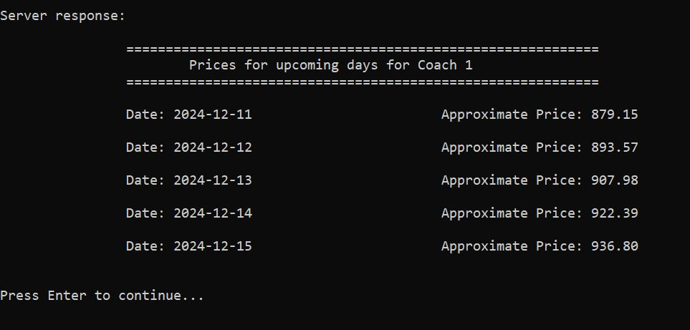
Dynamic Pricing

Slide 9
Socket Overview
Using socket programming, the devices are able to communicate with each other on a local network.
The server binds its socket to a specific IP address and port and waits for connection.
The client connects to the server using connect(), specifying the server's IP address and port.
The client sends requests to the server using send(), and the server responds using send() or write().
The server creates a new thread for each connected client using pthread_create(). This allows it to handle multiple clients simultaneously without blocking other connections.
Both the client and server operate on the same network. The server listens on INADDR_ANY (binds to all available network interfaces) or a specific IP address, and the client connects using the server's IP address.

Slide 10
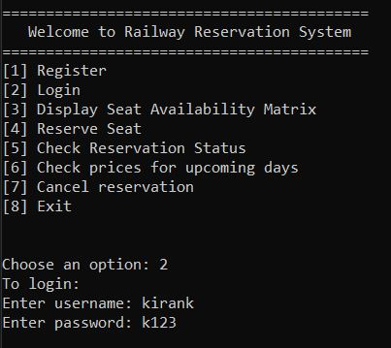
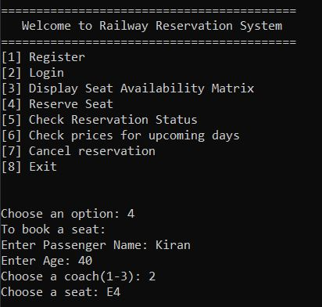
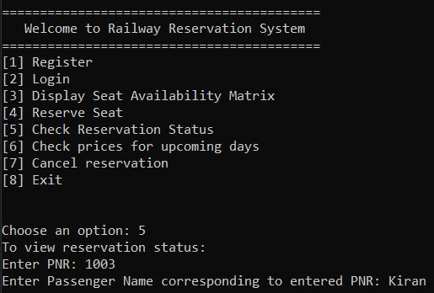
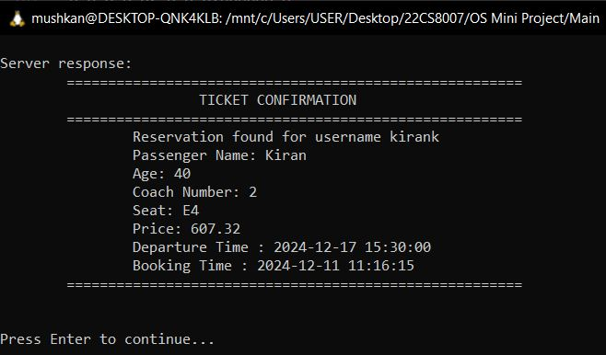
Socket Overview: Client

Slide 11
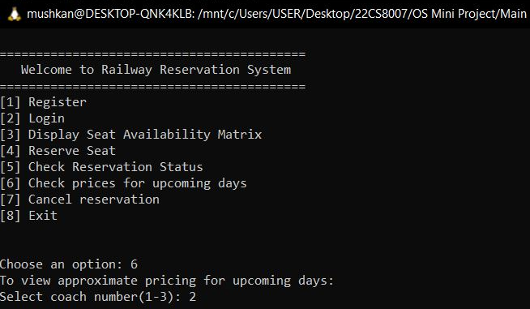
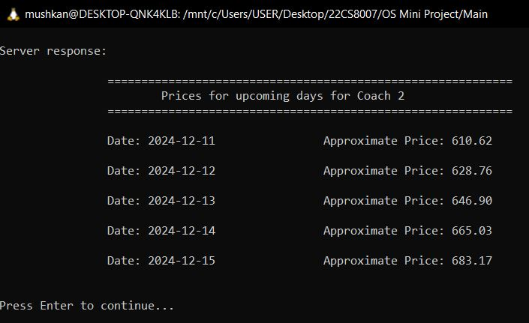
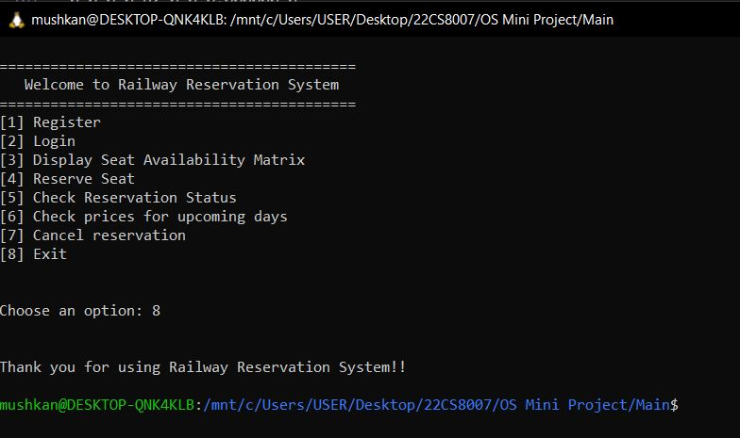
Socket Overview: Client

Slide 12
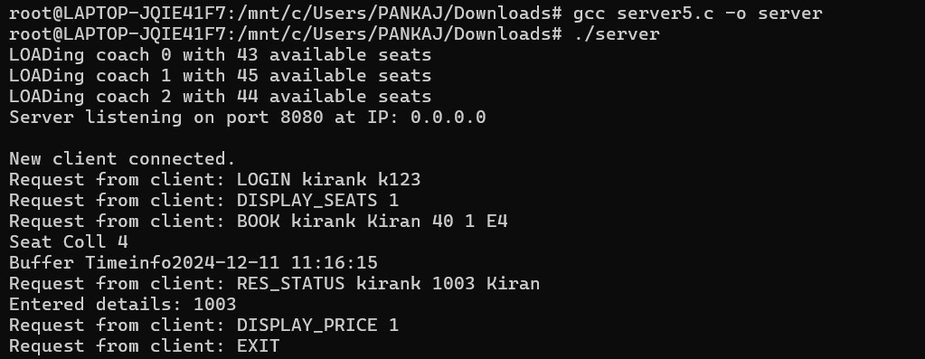
Socket Overview: Server

Slide 13
Member Contributions
Client Features: Anwesha, Sankar, Pratham, Hasin
Designing and maintaining the client features and defining logic to implement features like user registration, user login, reservation and cancellation of seats ,etc.
UI Design: Mushkan, Vaish, Aquib
Designing the user interface that the client and admin interact with, such as the client menu, seat matrix display, confirmation ticket, etc.
Server Features: Aryaman, Salman, Jahid
Designing and maintaining the server side code required for communicating with the client

Slide 14
Thank You

